Slide 1

Ministry of Tourism and Antiques
Designer: Saba Hatamleh
Supervised by:
Dr. Jalal Kiswani
Dr. William Smairat
Ms. Jacquelyn Brown
Ms. Hana AL Rasheed
Up-Skilling Project

Slide 2
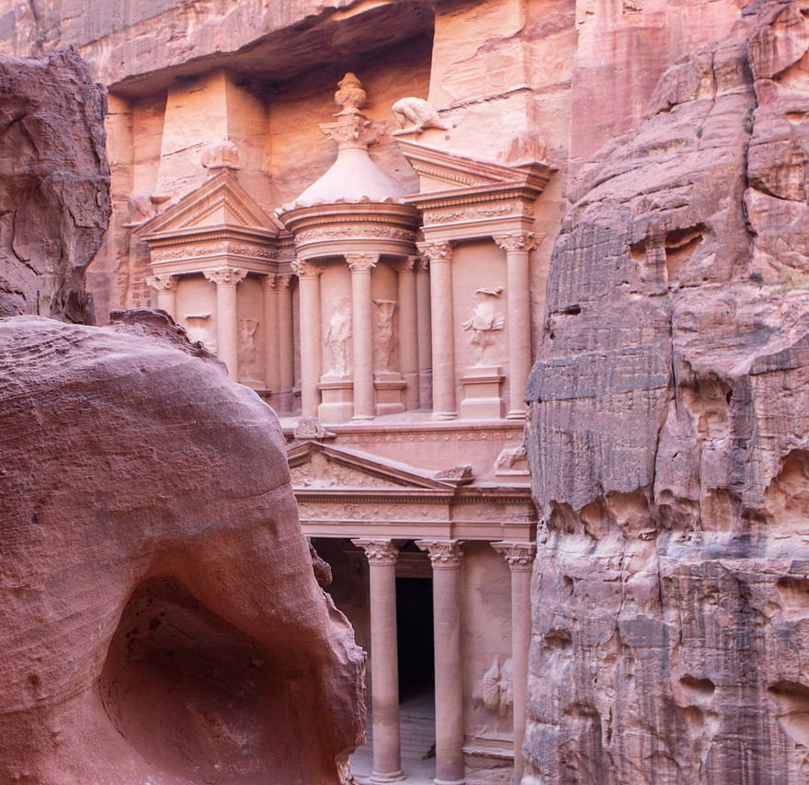
Introduction
According to the argent need of having an attractive website of such an important gate of Tourism in Jordan; the web site of Ministry of Tourism has been designed to be helpful, attractive and easy to use. At the same time that it provides the most needed services launching from the believe of web services and its need recently

Slide 3
Technology
Front End
HTML
CSS
Bootstrap
JavaScript
Backend
PHP
Database
MySQL

Slide 4
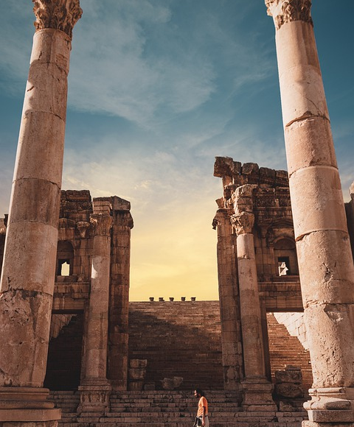
Services and Information
The website has 3 forms which represents 3 services:
the license form
compliant form
applying for a training program.
these e-services can reduce the user time and effort .
The visitor can reach all the information in the website like the latest news Journalism file of the Mistry and other information that the website provides .

Slide 5
Conclusion
After deep analyses and research of the needs of Ministry of Tourism website, I tried my best to come up with an attractive useful website that provides a rich information for the visitor that helps him to know more about the Ministry of Tourism and tourism sites in Jordan. In addition to the facilities and hotels in this vital sector. The web site also covers the latest news Journalism file of the Mistry. Also, it contains general information about the Ministry such as the minster word, organizational chart, compensations, regulations, and ministry projects and beds.

